Slide 1


AI Mirror
Supervised By : Dr/Salwa Osama

Slide 2
Team Members
Anas Saleh
Mahmoud Nasr
Mennatullah Essam
Mohamed Ashraf
Yara Mohammed
Mohamed Ihab

Slide 3
Outline
01
02
03
04
05
06
Introduction
Related Work
System Overview
Dataset & preprocessing
07
Experiment
Future Works
Conclusion

Slide 4
01
Introduction

Slide 5
Users today seek AI companions that feel more personal, emotionally aware, and relatable.
Current chatbots often fail to reflect the user’s unique style or emotional tone.
Our system creates AI characters that mirror the user’s personality, making conversations more natural and human-like.

Slide 6
02
Related work

Slide 7
Related work
features | AI Mirror | Replika | Character.Ai | Anima AI
Mimics user’s real personality | Yes (based on real data) | No | Limited (scripted) | Partially
Learns from real messages | WhatsApp , telegram , form | form | No | No
Matches user’s communication style & emotions | Fully | Emotionally Reactive | Scripted Responses | Tries To Adapt
Supports Avatar | Limited | Limited | No | Limited
Supports voice output | Yes | Yes | No | Yes (Basic)
User created character | Focus on one main character | No | Yes | No
Goal | Personalized self-mimicking AI | Emotional companion ai | Role-play with any character | Emotional chat companion

Slide 8
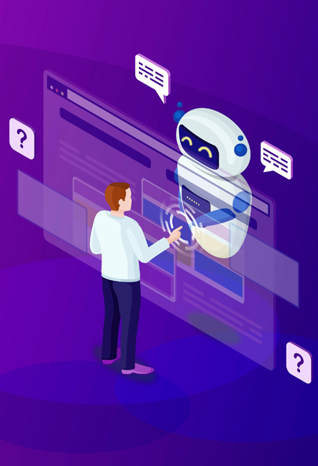
Contd.Related Work
Character100 : Unlike of using pre-defined data like in Character100, we collect a custom personality profile from the user at runtime, and use prompt engineering (rather than fine-tuning) to steer a powerful LLM (LLaMA 3.3 70B via Groq) to adopt that personality in real-time conversations.
Authors: Wendi Zhou, Yuxuan Wang, Yichi Zhang, et al. (COLING 2024) Results: 69.4 BLEU, 78.5 ROUGE-L, 74% style consistency.
Reference: https://github.com/nuaa-nlp/Character100/tree/main

Slide 9
Contd.Related Work
Retrieval-Augmented Generation for Knowledge-Intensive NLP Tasks : Proposed a Retrieval-Augmented Generation (RAG) framework that combines dense retrieval with sequence-to-sequence models to improve performance in knowledge-intensive NLP tasks like QA and fact generation.
Authors: Patrick Lewis, Ethan Perez, Aleksandra Piktus, et al. (NeurIPS 2020)
Results: Outperformed standard seq2seq baselines on tasks like Natural Questions and TriviaQA, with higher factual accuracy and relevance.
Reference : https://arxiv.org/abs/2005.11401

Slide 10
03
System Overview

Slide 11
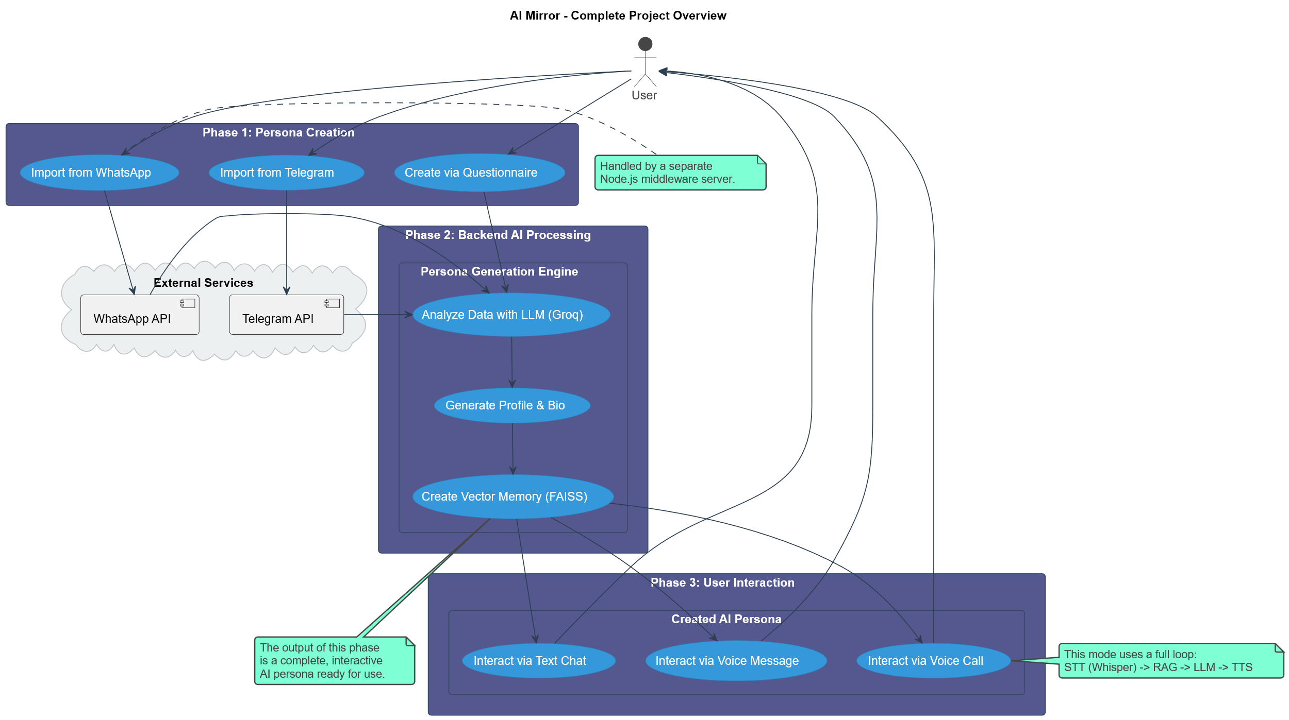

Slide 12
04
Dataset & Preprocessing

Slide 13
Dataset & Preprocessing
1
2
Data Sources:
WhatsApp chats (user uploads selected chat)
Telegram chats (user logs in, selects chat)
User questionnaire responses
Preprocessing Steps:
Extract and clean messages from target user
Summarize bio using LLMs
Extract Q&A pairs for character profile
Perform sentiment analysis for emotional context

Slide 14
Contd.Dataset & Preprocessing
3
4
Text Vectorization:
Use Sentence Transformers (all-MiniLM-L6-v2) to convert text to embeddings
Use FAISS for fast similarity search in vector space
Audio Processing:
Speech-to-Text via OpenAI Whisper for voice input
Text-to-Speech via PlayAI for voice output

Slide 15
05
Experiments

Slide 16
Experiment 1
Dataset
Model
Collected diverse Personas Datasets from Kaggle (Persona chat(ConvAI2)-facebook ΑΙ)
Phi-3 is a lightweight open-weight language model developed by Microsoft.
It is optimized for efficiency and strong reasoning, coding, and language tasks.
Designed to run well even on devices with limited hardware (like 8GB VRAM).
Algorithms
Result
LoRA is a fine-tuning technique that adds trainable low-rank layers
Integrated with Fast API backend Publish API with n-grok
Connected API with React Native Mobile App via Expo GO
The fine-tuning approach was abandoned in favor of exploring more efficient alternative methods, driven by the realization that more realistic and personalized data was needed instead of relying on generic public datasets

Slide 17
Experiment 2
Dataset
Model
Unique Character trial : FaceBook & Twiteer
Used voice recordings from a team member
Transcribed speech using Whisper Large V3 Turbo (supports Arabic dialects)
Avoided fine-tuning due to computational cost:
Used AI inference to process extracted text
Used Groq AI inference with Llama-3.3-70B Versatile
Algorithms
Result
AI Agent
The project was fully directed towards academic research to understand how to systematically build AI personas, moving away from quick solutions and focusing on creating a robust and sustainable architecture for simulation.

Slide 18
Experiment 3
Dataset
Model
Character 100
Sentiment Analysis :Identifies whether the tone is positive, neutral, or negative.
Emotion Detection: Extracts emotions from each utterance.
Topic Classification :Determines the main topic discussed.
Llama-3.1-8B-bnb-4bit :
High-Speed Fine-tuning
Strong Base Model
bnb-4bit Quantization
LoRA-Ready
Algorithms
Result
Fine-Tune using LoRA(low-rank adaptation)
Creating a Vector Store from the data we've prepared using FAISS + LangChain.
Using the RAG Pipeline with LLaMA + Retriever + Memory.
Although the model answered 75% of the questions correctly, providing it with data via RAG was not enough to simulate the persona. This proves that the problem is not a lack of information, but rather the model's need for advanced mechanisms (like memory and fine-tuning) to understand and embody personality traits.

Slide 19
Experiment 4
Dataset
Model
PersonaChat
Character 100
BlenderBot3(BB3) :
More Natural Dialogue
Learning from Users
Long-term Memory
Open Source
Algorithms
Result
Fine-Tune using LoRA(low-rank adaptation)
Creating a Vector Store from the data we've prepared using FAISS + LangChain.
Using the RAG Pipeline with LLaMA + Retriever + Memory.
The BB3 model, despite its excellence as an open-dialogue 'chatbot', is unsuitable for our project's primary goal. Its inability to stay aligned with the data makes it incapable of accurately simulating a specific persona, which emphasizes the importance of using models whose responses can be better controlled to be consistent with the persona's data.

Slide 20
Experiment 5 (Final Result):
Dataset
Model
WhatsApp
Telegram
Questionnaire
Prompt Engineering using :
meta-llama/llama-4-scout-17b-16e-instruct
with Groq Inference
Algorithms
Result
RAG(Retrieval-Augmented Generation)
FAISS for Memory(Vector Store)
Avatar
Voice Record
The final architecture has proven to be a complete success. By integrating RAG and memory techniques with real data from social platforms, the project successfully overcame the 'generic responses' problem and was able to build an AI agent capable of learning, evolving, and accurately simulating a specific persona.

Slide 21
06
Future Work

Slide 22
Future Work
Personalized Assistant Development: Enhance the digital character to closely mimic the user’s personality, communication style, and behavior, aiming to create a highly personalized assistant that reflects the user..
Voice Cloning Integration: Implement advanced voice cloning technologies to replicate the user’s voice, making it difficult to distinguish between the assistant and the real person.
Realistic Avatar Creation: Develop a lifelike 3D avatar that visually resembles the user, including facial expressions and gestures, to provide a more immersive and natural interaction experience.
Exploring Robotics Integration: In the future, explore the possibility of integrating the digital character with physical robotics to enable real-world interaction and expand use cases such as personal assistance, caregiving, or education.

Slide 23
07
Conclusion

Slide 24
Conclusion
Mimicking real human personas is a complex challenge that requires more than just generating text.
The proposed system demonstrated a unique approach by combining real user data, emotional understanding, and multi-modal output.
Unlike existing tools, it captured the true style, emotion, and voice of the user through real conversations and avatar simulation.
Overall, the project achieved a deep, personalized simulation that goes beyond standard AI chatbots.

Slide 25
Thank you
Any Questions?

